Slide 1




International Symposium on Software Testing and Analysis (ISSTA 2020)
Learning to Detect Table Clones in Spreadsheets
Yakun Zhang, Wensheng Dou, Jiaxin Zhu, Liang Xu,
Zhiyong Zhou, Jun Wei, Dan Ye, Bo Yang
University of Chinese Academy of Sciences
Institute of Software Chinese Academy of Sciences
^{Jinling Institute}
^{of Technology}
^{North China University}
^{of Technology}

Slide 2
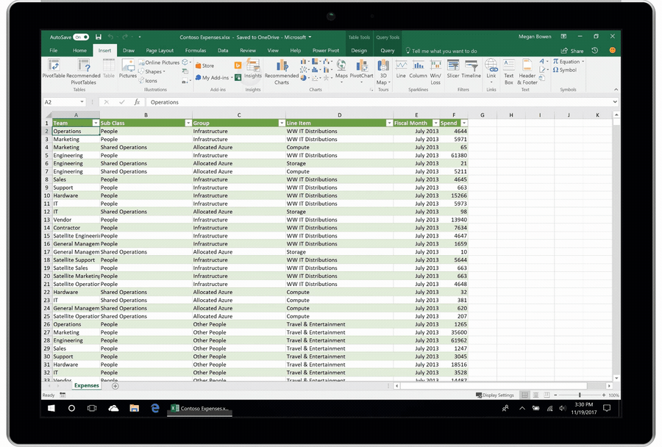


Benefits of Spreadsheets
Data Storage
Data Analysis
Financial Report

Slide 3

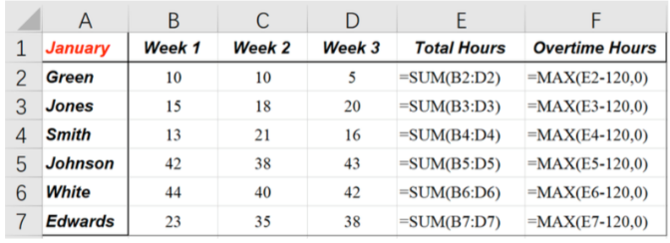
Cloning in Spreadsheet Development
How?
Similar report
Search
Copy & Paste
Update data
Fix formulas
New report

Slide 4
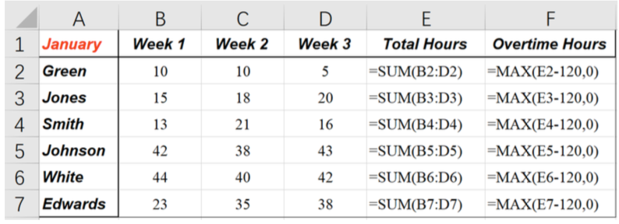
Table
Table: A rectangular block of cells, prescribing certain business task.
Element: Headers, data, formulas and cell formats.
Headers
Table
Data
Formulas

Slide 5
Table Clone
Table Clone: Two tables share the same or similar computational semantics.
Similar semantics!

Slide 6

No Records about Table Clones
How?
Similar report
Search
No records!
Copy & Paste
Update data
Fix formulas
New report

Slide 7
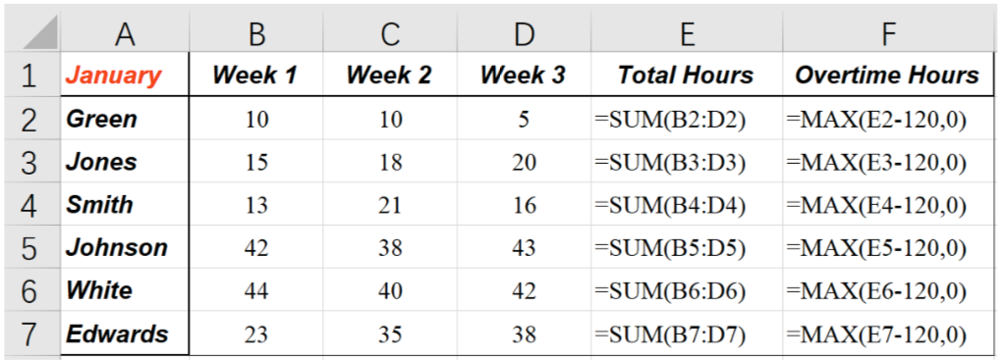
Applications of Table Clones
Error detection: Inconsistencies among corresponding cells can indicate errors.
Total Hours are SUM(RC[-3]:RC[-1])
Inconsistency
Total Hours are SUM(RC[-3]:RC[-2])

Slide 8
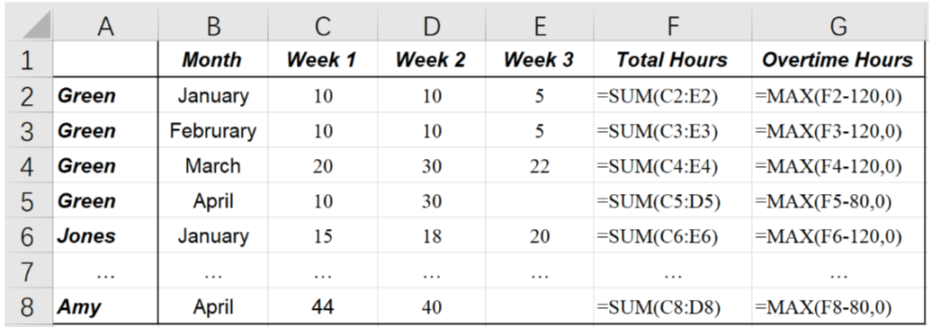
Applications of Table Clones
Data integration: Table clones can facilitate integrating all related tables into a consistent form.

Slide 9
Applications of Table Clones
Table template extraction: Table clones provide a pair of instances about how a table template is used.

Slide 10
Table Clone Types
Type-1: Identical tables allowing variations in formats.
Changed background colors
Identical contents

Slide 11
Table Clone Types
Type-2: Table clones have variations on data and formulas, and also variations in Type-1.
Changed data
Changed formulas

Slide 12
Table Clone Types
Type-3: Table clones have variations on table headers, and also variations in Type-2.
Changed headers

Slide 13
Table Clone Types
Type-4: Table clones have variations on rows / columns, and also variations in Type-3.
Changed rows
Changed columns

Slide 14
Existing Approach – Data Clone
Data clone: Two blocks of numerical cells with (almost) the same values [1].
Clone
Type-1 clones
[1] F. Hermans, et al., “Data clone detection and visualization in spreadsheets”, ICSE 2013.

Slide 15
Existing Approach – TableCheck
TableCheck: Two blocks of numerical cells with the same headers [1].
Clone
Type-1&Type-2 clones
[1] W. Dou, et al., “Detecting table clones and smells in spreadsheets”, FSE 2016.

Slide 16
Our Goal
LTC
Identify All Types of Table Clones
in Spreadsheets

Slide 17
Key Insight
Table clones share the similar structures and formats, even though they contain various modifications.
Similar
formats
Similar
headers
Similar
formulas

Slide 18






Approach Overview
Identify
Enumerate
Spreadsheet
Table
Table pair
Extract
Predict
Calculate
Clone or non clone
Binary classifier
12 features

Slide 19
Table Identification
Identify blocks that contain continuous cells.

Slide 20
Table Identification
However, a table can be separated into multiple blocks.
We merge blocks with the same row / column headers.

Slide 21
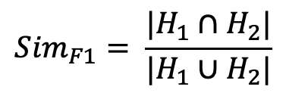


Features – Structure
Column / Row headers
How many common headers?
$$H_{1}$$
$${Sim}_{F1}= \frac{|H_{1}∩H_{2}|}{|H_{1}∪H_{2}|}$$
$$H_{2}$$

Slide 22
Features – Structure
Formulas
How many common parts in formulas?
SUM(RC[-3]:RC[-1])
SUM(RC[-2]:RC[-1])

Slide 23
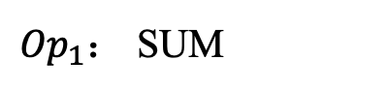
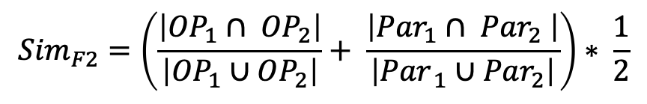
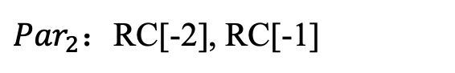
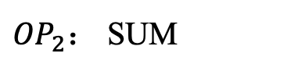
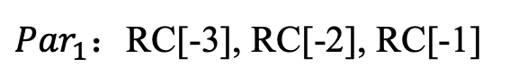
Features – Structure
Formulas
Operators
Parameters
${Op}_{1}$： SUM
SUM(RC[-3]:RC[-1])
${Par}_{1}$：RC[-3], RC[-2], RC[-1]
${OP}_{2}$： SUM
SUM(RC[-2]:RC[-1])
${Par}_{2}$：RC[-2], RC[-1]
$${Sim}_{F2}=\left(\frac{\left|{OP}_{1}∩ {OP}_{2}\right|}{\left|{OP}_{1}∪{OP}_{2}\right|}+ \frac{\left|{Par}_{1}∩ {Par}_{2} \right|}{\left|{Par}_{ 1}∪{Par}_{2}\right|}\right)∗ \frac{1}{2}$$

Slide 24
Features – Format
Font colors
How many common font colors?
Red
Black
Red：1
Black：41
Red：1
Black：29
Red
Black

Slide 25
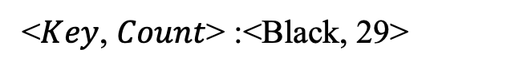

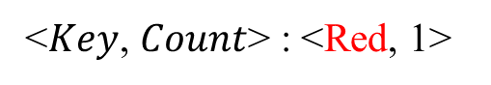
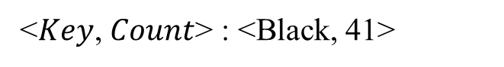
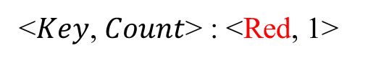

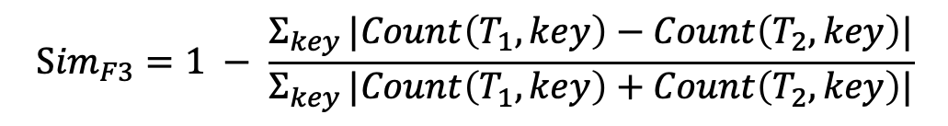
Features – Format
Key frequency distribution
How similar are their distributions of font colors?
<$Key$, $Count$> : <Red, 1>
$$T_{1}$$
<$Key$, $Count$> : <Black, 41>
<$Key$, $Count$> : <Red, 1>
$$T_{2}$$
<$Key$, $Count$> :<Black, 29>
$${Sim}_{F3}=1 − \frac{Σ_{key }|Count\left(T_{1}, key\right)−Count\left(T_{2},key\right)|}{Σ_{key }|Count\left(T_{1}, key\right)+Count\left(T_{2},key\right)|}$$

Slide 26
Feature Summary
Number | Feature name
1 | Column header
2 | Row header
3 | Formula
4 | Cell type
5 | Font color
6 | Font type
7 | Font style
8 | Bottom border
9 | Top border
10 | Left border
11 | Right border
12 | Background color
Structure features
Format features

Slide 27
Table Clone Identification
A group of table clones and non table clones
Binary classifier
Random Forest classifier
Calculate
Predict
12 features
Binary classifier
Clone or non clone

Slide 28
Evaluation
RQ1: How effective is LTC in detecting table clones in spreadsheets?
RQ2: How is LTC compared with existing techniques, e.g., TableCheck?
RQ3: Is LTC robust on different datasets?

Slide 29
Build Ground Truth
Experimental subject
EUSES [1]
Enron [2]
Sample spreadsheets and manually extract all table clones.
Sample 50 spreadsheets in EUSES and Enron, respectively.
Label table clones and non clones in the spreadsheets.
[1] M. Fisher, et al., “The EUSES spreadsheet corpus: a Shared resource for supporting experimentation with spreadsheet dependability mechanisms” , WEUSE I 2005.
[2] F. Hermans, et al., “Enron’s spreadsheets and related emails: A dataset and analysis”, ICSE 2015.

Slide 30
Ground Truth
Corpus | Category | Spreadsheet | Worksheet | Table clone | Non clone
EUSES | cs101 | 1 | 1 | 1 | 0
 | database | 9 | 18 | 12 | 6
 | financial | 12 | 27 | 134 | 1,349
 | forms3 | 1 | 2 | 14 | 239
 | grades | 4 | 7 | 9 | 9
 | homework | 4 | 6 | 27 | 397
 | inventory | 3 | 5 | 16 | 72
 | jackson | 3 | 9 | 31 | 596
 | modeling | 12 | 32 | 67 | 456
 | personal | 1 | 2 | 1 | 5
 | Total | 50 | 109 | 312 | 3,129
Enron |  | 50 | 107 | 338 | 7,086
Total |  | 100 | 216 | 650 | 10,215

Slide 31
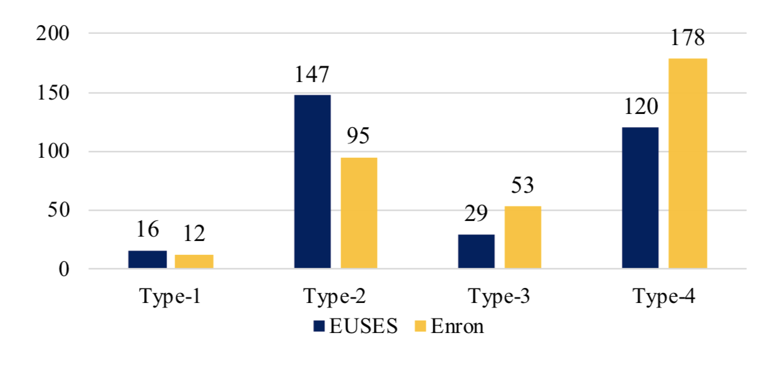
Table Clone Distributions
58.5% of table clones involve structure changes
(Type-3 and Type-4).
58.5%

Slide 32
Experimental Design
Experimental design
Training set (70 spreadsheets)
Testing set (30 spreadsheets)
 | Corpus | Spreadsheet | Table clone | Non clone
Training | EUSES | 35 | 221 | 2,635
 | Enron | 35 | 239 | 5,487
 | Total | 70 | 460 | 8,122
Testing | EUSES | 15 | 91
 | Enron | 15 | 99
 | Total | 30 | 190

Slide 33
How Effective is LTC? (RQ1)
Precision: 97.8%
Recall: 92.1%
F1-measure: 94.9%
Corpus | Spreadsheets | Table Clone | Detect | True
EUSES | 15 | 91 | 86 | 84
Enron | 15 | 99 | 93 | 91
Total | 30 | 190 | 179 | 175 (97.8%)

Slide 34
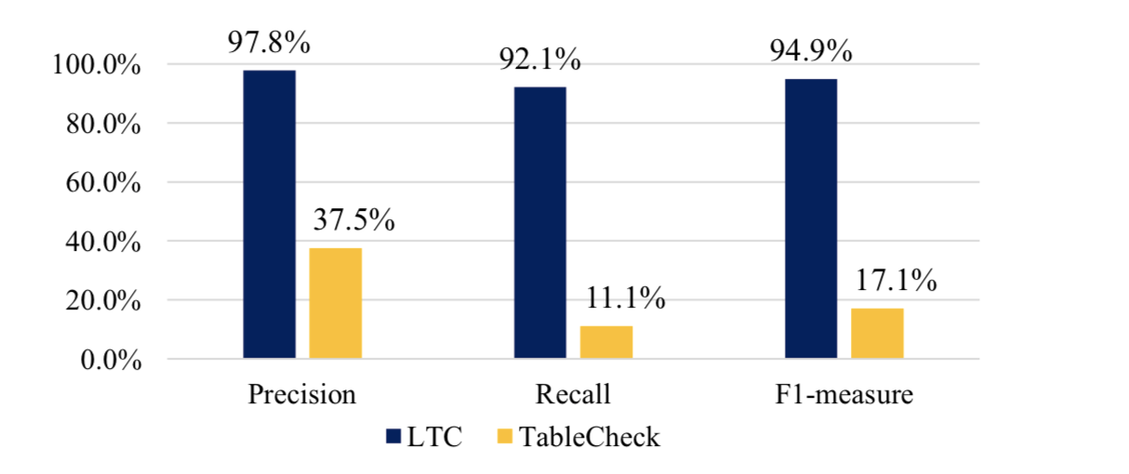
Compare with TableCheck (RQ2)
LTC significantly outperforms TableCheck[1] in table clone detection.
[1] W. Dou, et al., “Detecting table clones and smells in spreadsheets”, FSE 2016.

Slide 35
Is LTC robust? (RQ3)
Experimental subject
FUSE [1]
EUSES [2]
Enron [3]
LTC can detect inter- and intra- spreadsheet table clone precisely.
Spreadsheet | Intra-spreadsheet clone |  |  | Inter-spreadsheet clone
Corpus | Clone | Sampled | Precision | Clone | Sampled | Precision
EUSES | 2,576 | 100 | 97.0% | 1,156 | 100 | 86.0%
Enron | 289 | 100 | 93.0% | 1,332 | 100 | 94.0%
FUSE | 1,397 | 100 | 98.0% | 2,647 | 100 | 97.0%
Total | 4,262 | 300 | 96.0% | 5,135 | 300 | 92.3%
[1] T. Barik, et al., “FUSE: A reproducible, extendable, internet-scale corpus of spreadsheets”, MSR 2015
[2] M. Fisher, et al., “The EUSES spreadsheet corpus: a Shared resource for supporting experimentation with spreadsheet dependability mechanisms” , WEUSE I 2005.
[3] F. Hermans, et al., “Enron’s spreadsheets and related emails: A dataset and analysis” , ICSE 2015.

Slide 36
Summary
Table clones are common in spreadsheets, in which two tables share the similar computational semantics.
LTC: A learning-based approach to automatically detect table clones with or without structure changes.
LTC can detect table clones with the high precision and recall.

Slide 37

Thank you!

